Slide 1
INFO-3142
Emerging Technologies

Slide 2
Contact Information
jcooper@fanshawec.ca
Office hours:
As arranged

Slide 3
Course Framework
2 hours in-class lecture, demonstration, tutorial/help session
All lecture and demonstration classes are recorded
Section 01: Monday 8:00 am – 10:00 am (M3043)
Section 02: Wednesday 3:00 pm – 5:00 pm (R1020)
Section 03: Thursday 6:00 pm – 8:00 pm (M3043)
1-hour asynchronous online session:
This class is a recording once a week that will always be some combination of lecture and demonstration

Slide 4
Assumptions
Introductory knowledge of Python
We’ll do a short Python review and cover any new Python skills required at the beginning of the course and later as needed

Slide 5

1. Resources
Python textbook (free)
Naomi Ceder
PDF or Paperback
GitHub Link for PDF
Software (IDE)
Visual Studio 2022
or
VS Code
Jupyter

Slide 6

2. Resources
Main textbook (required)
Sebastian Raschka
PDF or Paper
Manning.com
Software
Python 3.11 or higher (64)
PyTorch Download
TensorFlow

Slide 7
Course Evaluation
Midterm Test (Quiz) – 20%
Final Test (Quiz) – 20%
Projects – 40%
2 Projects, each worth 20%
Labs – 20%
5 labs, each worth 4%

Slide 8
Evaluation
Tests will be done during weekly scheduled class times
Dates are posted on FOL
Projects are made available as PDF project descriptions and will be due as specified
Labs are intended to develop specific skill sets
Each lab will be made available:
During a scheduled class
Some time will be available for working on labs at the end of class
Each lab will be due:
At 11:30 pm on the day of the next weekly class

Slide 9
1. Content Delivery Framework
Published content “Files” will be uploaded to the following FOL folders as required each week
Slides
Examples
Labs
Projects
Recordings

Slide 10
2. Content Delivery Framework
In addition, all content artifacts for a given week will be published in a weekly folder on FOL
For Example:
Week 1
Week 2
Week 3
…
Week 14

Slide 11
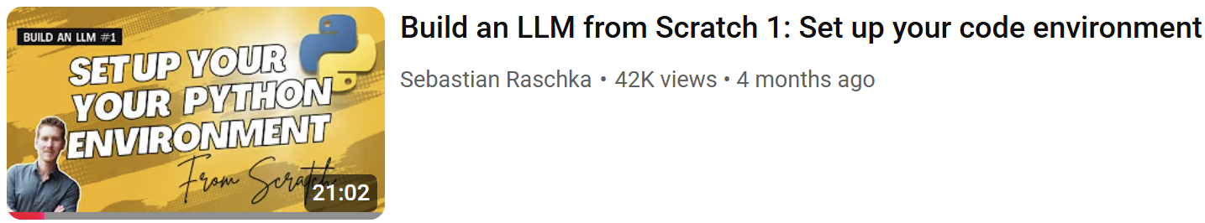
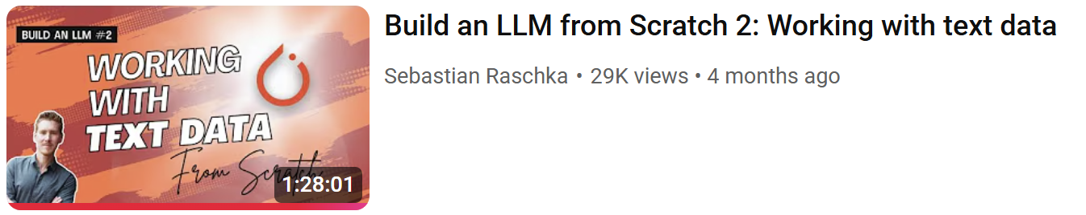
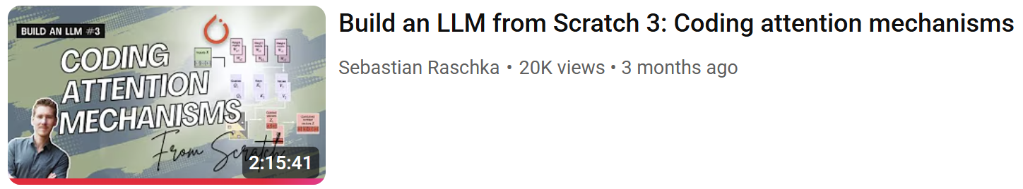
1. Resources – Textbook Videos (older)

Slide 12
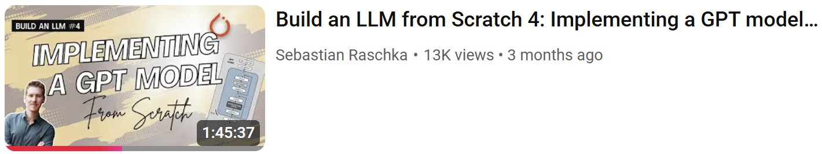
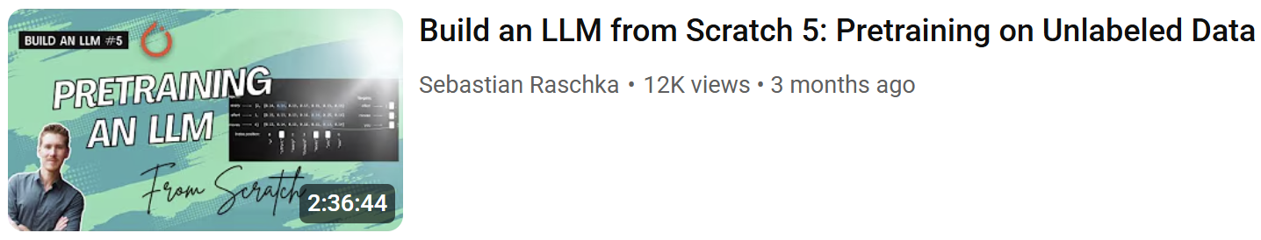
2. Resources – Textbook Videos (older)

Slide 13
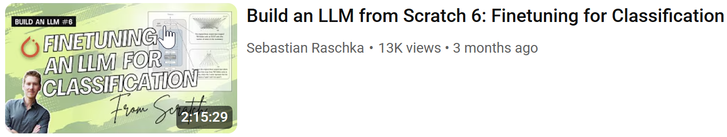
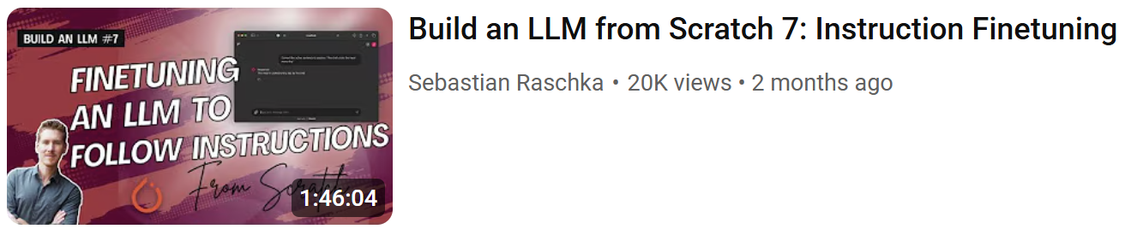
3. Resources – Textbook Videos (older)

Slide 14
Sebastian Resources
Sebastian Raschka web site
GitHub repository
Meet the Author
PyTorch in One Hour
Most Recent Textbook Videos

Slide 15
Other Resources
https://survey.stackoverflow.co/2025/
https://survey.stackoverflow.co/2024/

Slide 16
What’s the Course All About?
Building a GPT Large Language Model
AI-Assisted Coding
Artificial General Intelligence

Slide 17
What Should I Do Until Next Week?
Get the textbook
Watch “Python Environment Setup”
Install software
Run MNIST example
Revisit Python

Slide 18
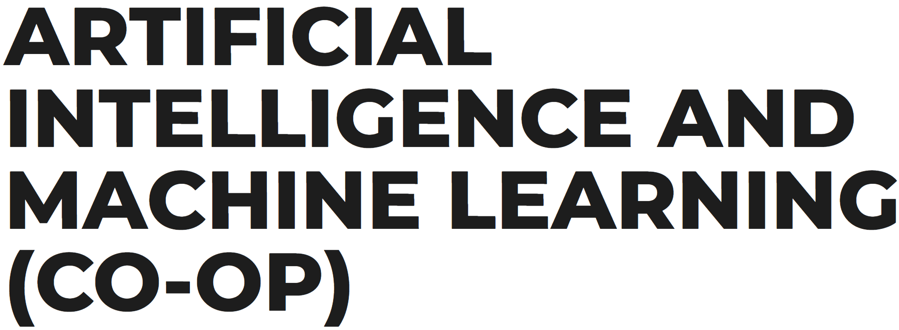
What’s Next after this Term if I’m Into AI?

Slide 19
1. AIM2 Program Overview
The AI and Machine Learning one-year graduate certificate program is designed for students who have completed a university computer science degree, college software development diploma program or have an equivalent education or work experience.
With a focus on deep learning neural networks, students will discover how to design and deploy cutting-edge technologies such as convolutional neural networks, recurrent neural networks and generative adversarial networks in areas such as healthcare, bioscience, manufacturing, financial services and supply chain sectors. Students will also work with mainstream technologies such as Google's TensorFlow to train various machine learning models using big data and state-of-the-art hardware
Not only will students gain extensive technical knowledge of AI and Machine Learning, but they will also learn and apply skills in project management, communication and teamwork through hands-on, industry-based research projects and a comprehensive in-class capstone project
In their final semester, students will complete a paid, co-operative work term with an industry partner

Slide 20
2. AIM2 Program Overview
Semester 1 – Winter 2026
Course ID | Course Name | Hours
INFO-6146 | TensorFlow and Keras with Python | 4
INFO-6147 | Deep Learning with PyTorch | 3
INFO-6148 | Natural Language Processing 1 | 4
INFO-6149 | Machine Learning Security | 3
INFO-6150 | Data Mining and Analysis | 3
INFO-6151 | Data Visualization for Machine Learning | 3
COOP-1020 | Co-operative Education Employment Prep | 1

Slide 21
3. AIM2 Program Overview
Semester 2 – Spring/Summer 2026
Course ID | Course Name | Hours
INFO-6152 | TensorFlow and Keras 2 | 4
INFO-6153 | Natural Language Processing 2 | 4
INFO-6154 | Machine Learning Optimization Strategies | 3
INFO-6155 | Social Media Analytics | 3
INFO-6156 | Capstone Project | 6

Slide 22
4. AIM2 Program Overview
Semester 3 – Fall 2026
Paid Co-op work term

